Slide 1
Camera Traffic Counts: Modeling
By: John Trelford, Lucas Chiang, Travis Welsh, Brian Pham, and Ritesh Penumatsa
(Group 11)

Slide 2
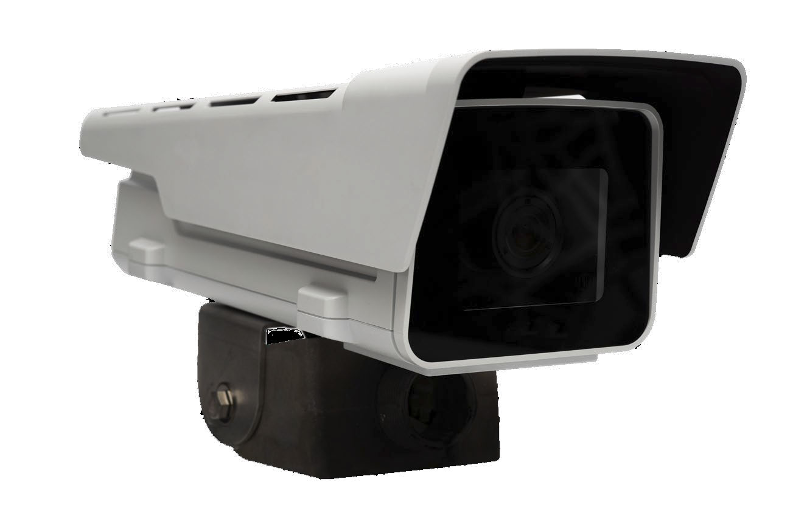
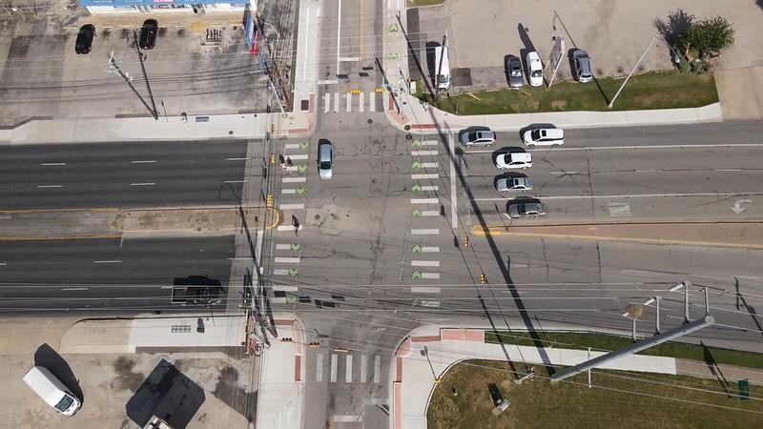
Dataset Overview
Camera Traffic Counts:
15-minute interval traffic by intersection in Austin
Collected by GRIDSMART optical traffic detectors
AC3 Camera (traffic detector)

Slide 3
Subsetted Data
How?
Filter to only rows where year = 2019
14,717,624 rows in dataset where year = 2019
Why?
Prevents interference from the COVID-19 pandemic period
The full Camera Traffic Counts dataset was 82.1 million rows
  Overwhelms RAM
  Computationally Intensive
Shape - (Rows, Columns): (14717624, 19)

Slide 4
Predictive Problem 1: Predicting expected volume of vehicles given day of the week and time

Slide 5
Problem Setup
Input Variables: Day of Week, Time
Target Variable: Volume
Real-valued outcome
Justification of Feature Set:
Data is available for every observation
No leakage - predictors come before the prediction
Expected signal - volume follows time-based patterns
Day of the week was one-hot encoded to properly weight the categorical variable (day of the week).

Slide 6
Choice of Model Class and Justification
Model Class 1: Linear Regression
Appropriate for temporal data with smoothly changing trends
Easy to interpret the coefficients
Low variance
Low computational cost
Avoids overfitting (few features yet millions of samples)
Model Class 2: Random Forest
Able to model complex relationships between variables
More resistant to outliers in the data

Slide 7
Evaluation and validation procedure
How we split the dataset?:
Training set: January-October
Testing set: November-December
Avoids temporal leakage, so only past data predicts future observations
  Ensures an unbiased estimate of generalization because it simulates the real world scenario of predicting traffic volume without knowledge of the future.
k-fold CV is inappropriate because it breaks the time order
Justify metric choice(s) by the decision/prediction context:
RMSE ensures there are no massive mispredictions
R-Squared indicates how well the model captures the overall trends

Slide 8
Choice of Hyperparameters and Loss Function
Linear Regression:
  No tunable hyperparameters
  Search method: minimizing MSE
    Penalizes larger errors more heavily, and we want to protect against large mispredictions

Slide 9
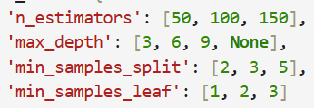
Hyperparameters and Loss Function
for Random Forest
Created a subset of 500,000 randomly selected rows
Used a random search method to test 20 combinations of optimal values for n_estimators, max_depth, min_samples_leaf, and min_samples_split.
This is better than a grid search because of the data set’s large size.
n_estimators: 50
max_depth: 9
min_samples_leaf: 2
min_samples_split: 5
Random Forest automatically uses MSE for the loss function. It is a good fit because the target (volume) is a continuous variable.
The MSE was found to be 3377.39.

Slide 10
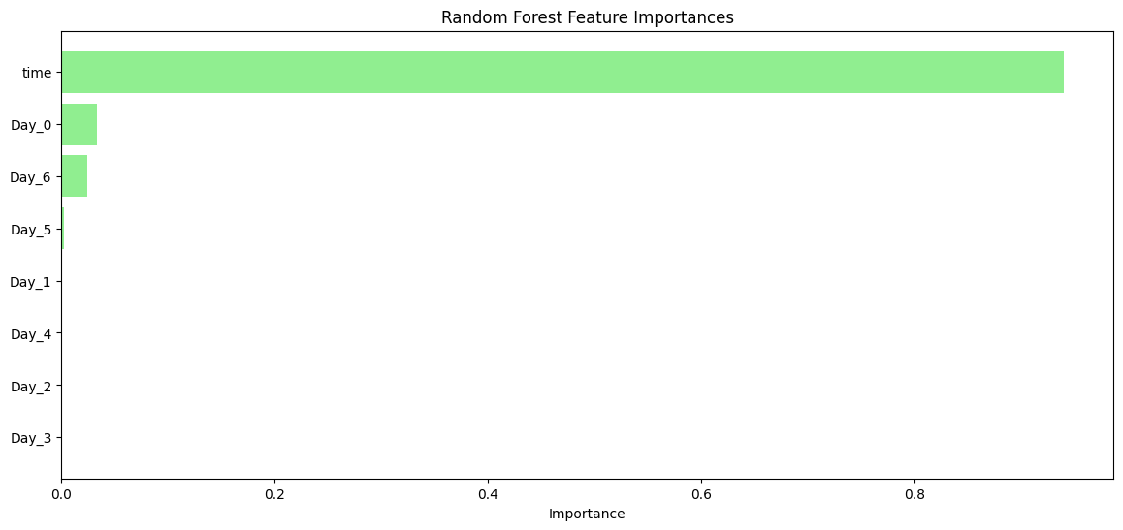
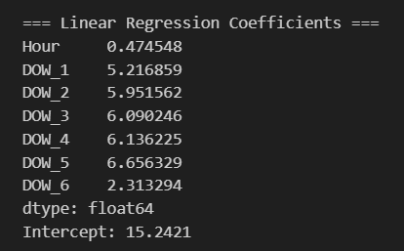

Slide 11
Evaluation and conclusion
Linear Regression:
RMSE: 59.12
R-Squared: 0.0013
Training Time: 4.61 seconds
Energy consumed: 0.000288 kWh
CO2 emissions: 0.000137 kg CO2eq
Random Forest:
RMSE: 58.1373
R-Squared: 0.0344
Training Time: 8 minutes, 44.26 seconds
Energy Consumed: 0.007644 kWh
CO2 Emissions: 0.003639 kg CO2 eq
Overall, random forest is more precise due to a larger r-squared value. However, it is significantly more computationally intensive than linear regression. As such, random forest is the preferred model assuming adequate computational power, which would be expected for city planners.

Slide 12
Predictive Problem 2:
Predicting average speed of vehicles with precipitation type (rain vs. snow) and temperature.
Notes:
Can be useful for people using GPS to see certain how environmental factors affect their travel time. We can utilize this to improve road safety measures based on higher precipitation and temperature rates. Brian

Slide 13
Problem Setup
Input Variables: Average Precipitation (in), Average Snow (in), Average Temperature (ºF)
Other Feature Variables: Volume, Month, Day, Year, Day of the Week
Decided to drop non-transformed categorical variables (i.e. record ID) because it would not be applicable in this problem.
Target Variable: Average Speed (mph)
Justification of Feature Set: We want to use as many variables as possible to adjust for other factors influencing traffic speed, allowing the model to improve predictions. Weather features such as historical average precipitation, snow, and temperature on a given day are available, so their use does not introduce data leakage or bias in a real-world predictive task.
Notes:
Brian
Included other feature variables to maintain accuracy due to seasonality of the weather dataset

Slide 14
Choice of Model Class and Justification
Model Class 1: Random Forest Regression
Model Class 2: Gradient Boosting Regression
Why?
Random Forest Regression: Robust, averages multiple trees to capture nonlinear relationships and interactions.
Gradient Boosting Regression: Builds trees sequentially to correct errors, capturing subtle patterns for higher accuracy.
Reason for using both: Allows comparison of parallel vs. sequential learning and ensures reliable predictions.
Notes:
Brian

Slide 15
Evaluation and Validation Procedure
Dataset Split:
80% training, 20% testing. Split the samples into the first 80% of the data sorted by dates as training and the remaining 20% of the data sorted by dates as testing
Validation Procedure:
GridSearchCV: 5-fold CV used to systematically tune hyperparameters, ensuring the model generalizes well and selects the best parameter combination.
Cross-Validation: Splitting the training data into 5 folds allows each subset to serve as a validation set once, providing a robust estimate of model performance and reducing variance from a single split.
Train-Test Split: Held-out test set evaluates final model performance on unseen data, providing an unbiased estimate of real-world predictive accuracy.
Evaluation Metrics:
R²: Measures the proportion of variance explained by the model.
RMSE: Quantifies prediction error in miles per hour.
These metrics together provide a clear and comprehensive assessment of model fit and reliability.
Notes:
Lucas - For our dataset split, we did an 80/20. In our validation procedure, we decided to perform a GridSearch cross validation to tune our hyperparameters (which is using a an exhaustive list and going through each combination. This allows us to ensure the model generalizes well and selects the best parameter combination, and of course the cross validation allows us to provide a robust estimate of how well the model does on each fit, and as I mentioned before the holding out of the test set helps us get an unbiased estimate during prediction. For our evaluation metrics, we decided to use R^2, and RMSE.

Slide 16
Evaluation and Procedure cont.
Justification of Metrics:
R² indicates how well the model captures the total variance explained by traffic speed.
RMSE ensures errors are small in practical terms, which is critical for accurate traffic speed predictions. It is also in MPH, which is interpretable
Notes:
Brian

Slide 17
Choice of Hyperparameters and Loss Function
Key Hyperparameters Tuned:
n_estimators, max_depth, learning_rate, min_samples_split, min_samples_leaf
Search Method: GridSearchCV with 5-fold cross-validation
Stopping Criteria: Number of trees (n_estimators) and early stopping, which is based on when validation performance stops improving
Loss Function Justification:
Optimized mean squared error (MSE), suitable for our continuous target variable (average speed in miles per hour). MSE penalizes larger errors more heavily, encouraging the model to minimize significant mispredictions.
Link Between Surrogate Loss and Decision Metrics:
The model learned by minimizing MSE, but we reported R² and RMSE since they better describe how well predictions match real traffic speeds. RMSE is more of an intuitive measure of prediction accuracy, helping connect the optimization goal to real-world performance.
Notes:
Ritesh; If the validation performance stops improving — meaning the validation loss (like MSE) stops decreasing or even starts increasing — for a defined number of iterations (called “patience”), the training stops early.

Slide 18
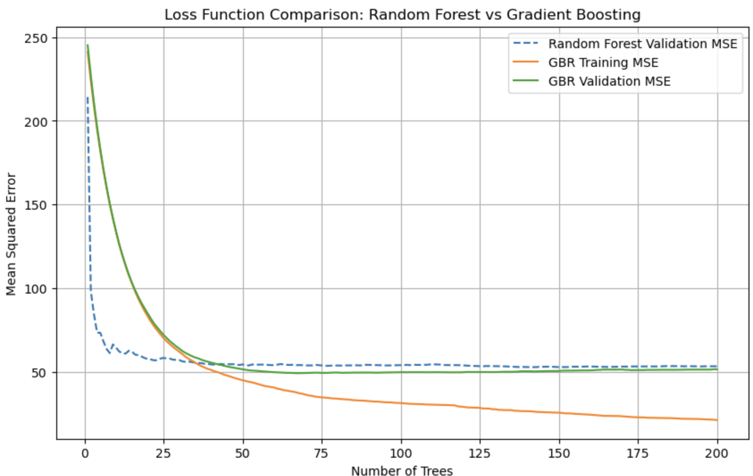
Notes:
Ritesh

Slide 19
Evaluation
Random Forest Regressor (RFR):
Best Parameters: {'max_depth': None, 'min_samples_leaf': 2, 'min_samples_split': 2, 'n_estimators': 200}
Best CV (Training): R² ≈0.7518 (across 5 folds)
Test Performance: R² ≈ 0.809, RMSE ≈ 0.194
Interpretation: Strong predictive performance; robust to nonlinear relationships and feature interactions.
Gradient Boosting Regressor (GBR):
Best Parameters: {'learning_rate': 0.05, 'max_depth': 7, 'min_samples_leaf': 4, 'min_samples_split': 10, 'n_estimators': 100}
Best CV (Training): R² ≈0.7498 (across 5 folds)
Test Performance: R² ≈ 0.813, RMSE ≈ 0.436
Interpretation: Comparable predictive accuracy; sequential boosting captures subtle patterns but has a higher RMSE than RFR.
Notes:
Ritesh

Slide 20
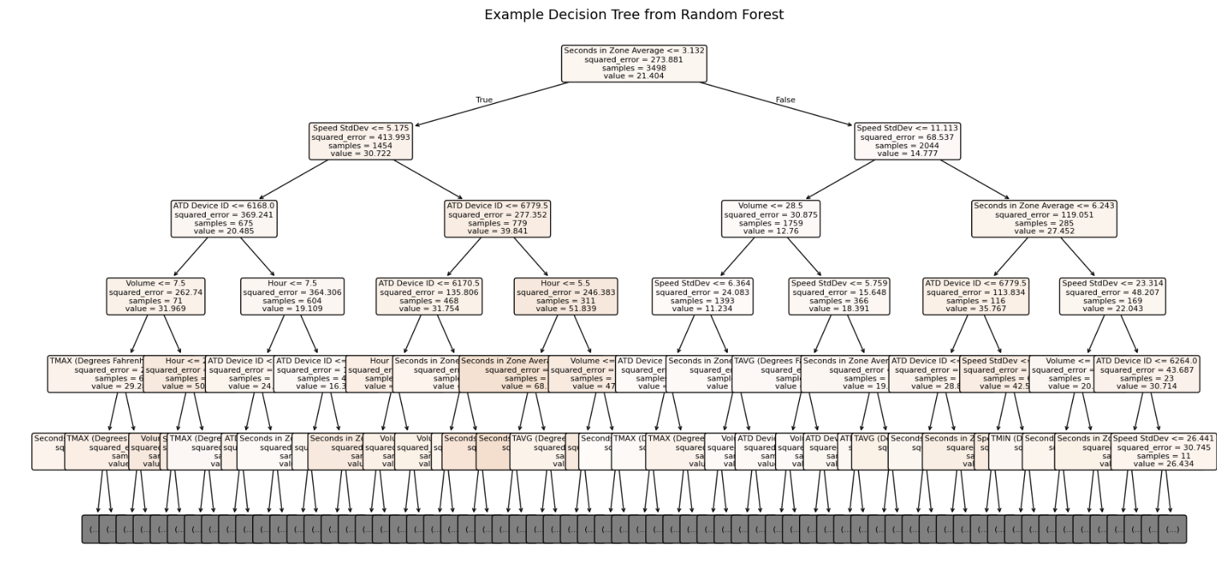
Notes:
Ritesh

Slide 21
Computation / Energy Considerations
Total Model Fits:
The Gradient Boosting Regressor (GBR) required significantly more compute, involving 1,215 total fits (243 candidates × 5 folds). The Random Forest Regressor (RFR) was substantially more efficient, requiring only 120 total fits (24 candidates × 5 folds).
Training Time per CV Fit:
Individual training times varied, with each cross-validation fold for the GBR taking approximately 1.7–6.9 seconds, depending on the complexity of the hyperparameters.
Energy Optimization:
To manage computational resources and limit energy usage, we employed a moderate dataset size and restricted the hyperparameter search space (param_grid). Specifically for GBR, we utilized pruning to get smaller n_estimators and shallower trees to reduce training complexity and energy consumption.
Normalized Cost of Prediction:
Both optimized models are highly efficient post-training. The cost of a single prediction is fast (milliseconds), confirming their suitability for real-time applications such as traffic speed estimation.
Notes:
Lucas (pruning)

Slide 22
Computation / Energy Considerations
Model | Total Training Fits | Avg. Training Time per Fit (s) | Energy Consumed (kWh) | CO₂ Emitted (kg CO₂ eq)
Random Forest Regressor (RFR) | 120 | 1.2 | 0.031 kWh | 0.013 kg CO₂ eq
Gradient Boosting Regressor (GBR) | 1,215 | 3.9 | 0.142 kWh | 0.061 kg CO₂ eq
The GBR consumed ~4.6× more energy and emitted nearly 5× more CO₂ than the RFR.
RFR seems to be the better cost-efficient model.
Notes:
Lucas

Slide 23
Which Model Performed Better?
Both the Gradient Boosting Regressor and the Random Forest Regressor had a similar R²≈ 0.81.
The RFR has a lower RMSE, suggesting marginally more precise predictions.
GBR may however offer greater insight into complex non-linear feature interactions through its feature importance scores.
RFR had a faster performance because of fewer candidates per fit.
Final Choice: The Random Forest Regressor is the preferred model because of its lower RMSE, faster training time, and lower sensitivity to hyperparameter tuning than GBR. It not only explains 81% of the speed changes, but it does so with an average prediction error of less than 0.2 mph, making it both highly reliable and significantly more sustainable for a real-time traffic system.
Notes:
Ritesh

Slide 24
Thank You!
Any Questions?

